Slide 1
We speak your language.

Slide 2
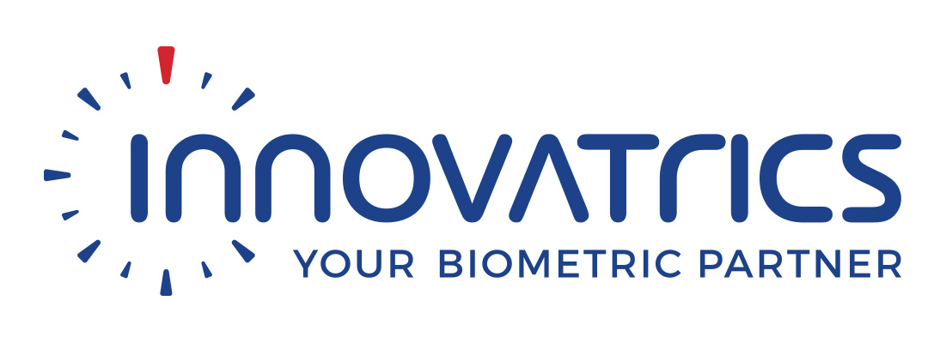
nettle AI
Team of seasoned coders, ambitious data scientists and trusted industry business specialists passionate about building solutions designed to deliver natural language enabled, conversational style interactions.
Proud to be official members of the NVIDIA Inception programme and the SAP Open Ecosystem Partner programme.
Strategic alliance partners with Biometric technology leaders Innovatrics and contact centre solution leader Genesys.

Slide 3
our focus
We are creating AI driven Natural Language Processing (NLP) solutions:
text mining toolsets
entity detection and intent classifications engines
conversational solutions aka chatbots
Our solutions are designed to help automate and streamline customer care or increase sales in a user-friendly manner.

Slide 4
nettle AI do-it-for-me

Slide 5
issues with traditional online
The most common frustrations reported by consumers:
websites being hard to navigate (34%)
not being able to get answers to simple questions (31%)
basic details about a business - like address, hours of operations, and phone number - being hard to find (28%)
The takeaway: The online experiences businesses are providing no longer match the way people prefer to buy.
Source: The 2018 State of Chatbots Report: How Chatbots Are Reshaping Online Experiences

Slide 6
DIFM
Apps allowed consumers to do-it-yourself (DIY), the addition of AI, chatbots and voice-based digital assistants are enabling a do-it-for-me (DIFM) approach.
Speedy and personalised competent customer service anytime, anyplace.
Services & information without having to spend time digging for it.
We used to measure success by the amount of time customers spent on your site or app, but now it’s about time saved - we often say “time is the new coupon”- and the frequency of return visits, as people find the answers they need more quickly.

Slide 7
use cases for chatbots
The most common predicted uses for chatbots that consumers reported:
getting quick answers to questions in an emergency (37%)
resolving a complaint or problem (35%)
and getting detailed answers or explanations (35%)
Source: The 2018 State of Chatbots Report: How Chatbots Are Reshaping Online Experiences

Slide 8
nettle AI chatbot in action

Slide 9
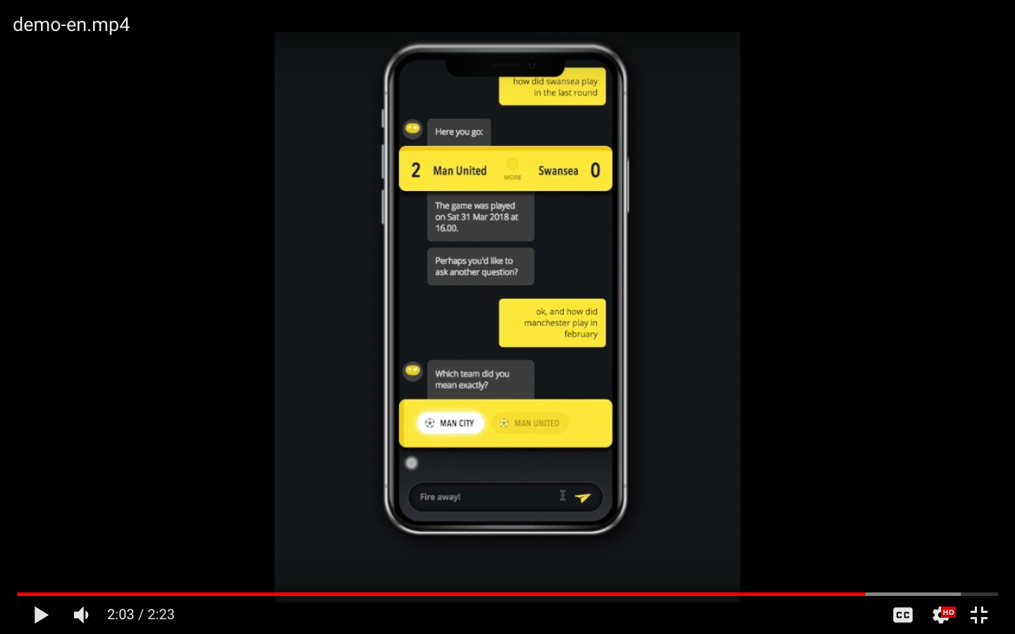
nettle AI chatbot – on click video play

Slide 10
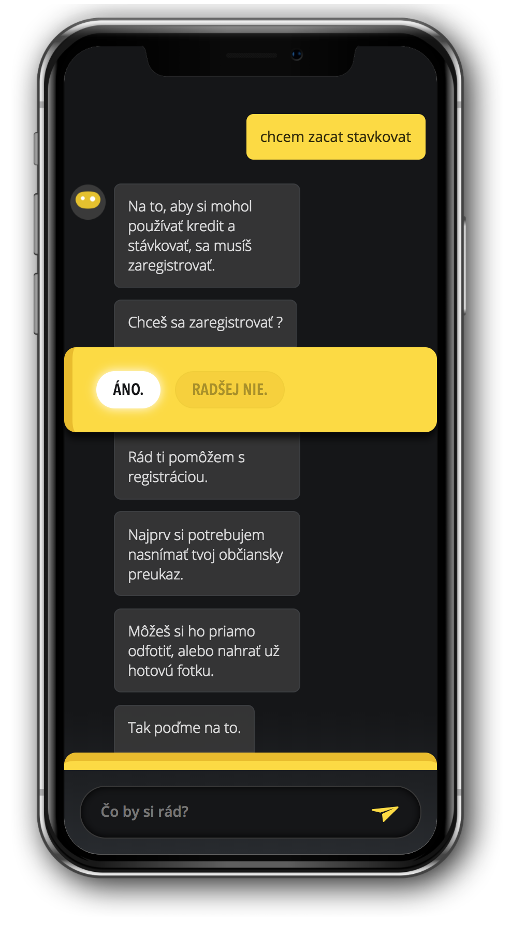
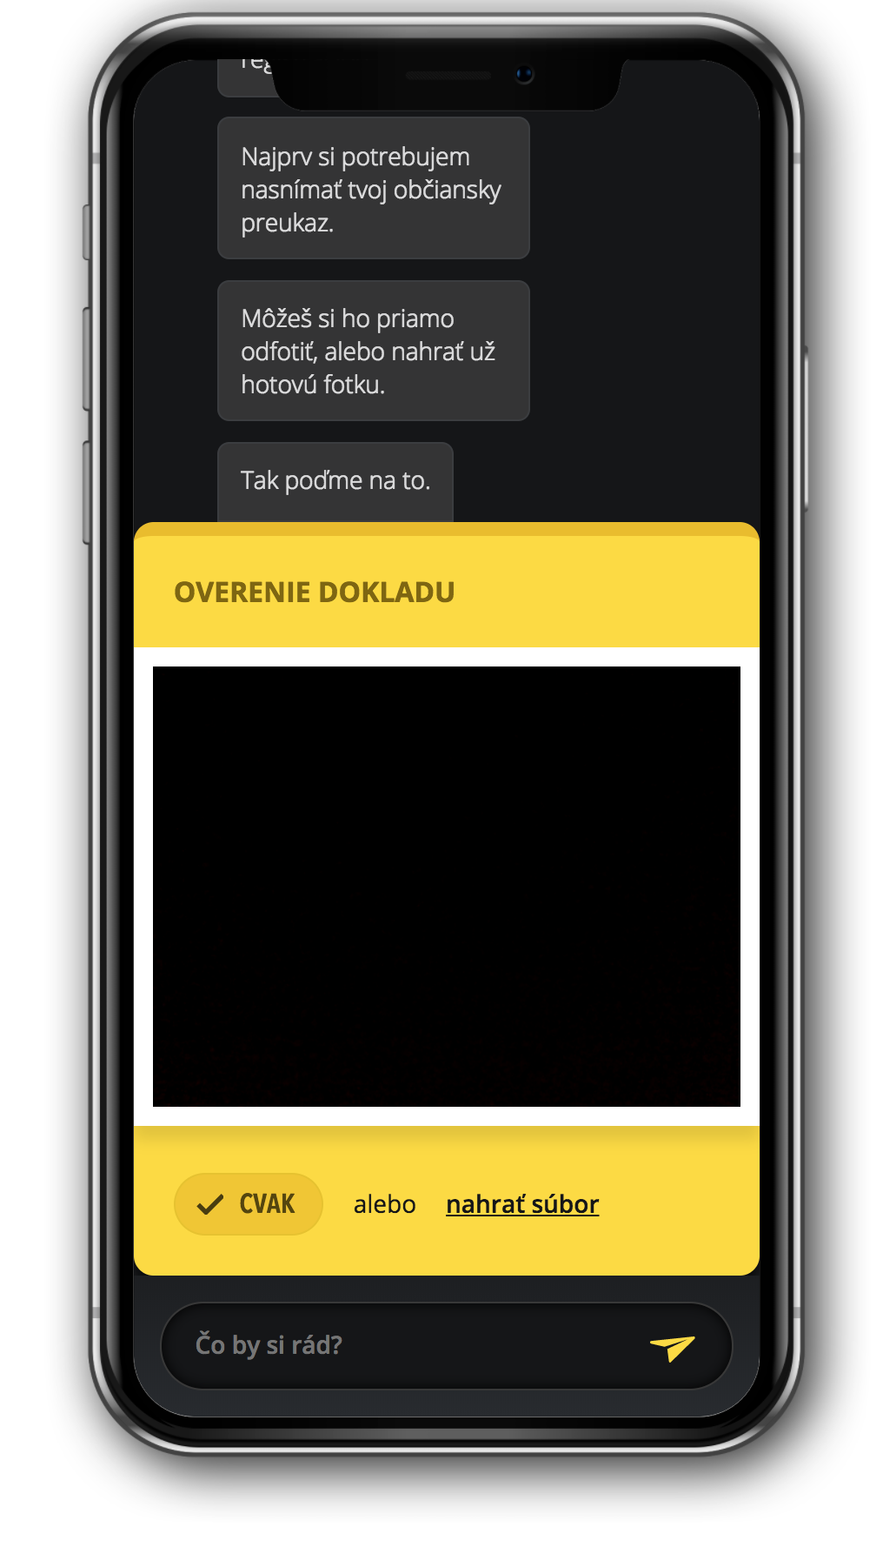
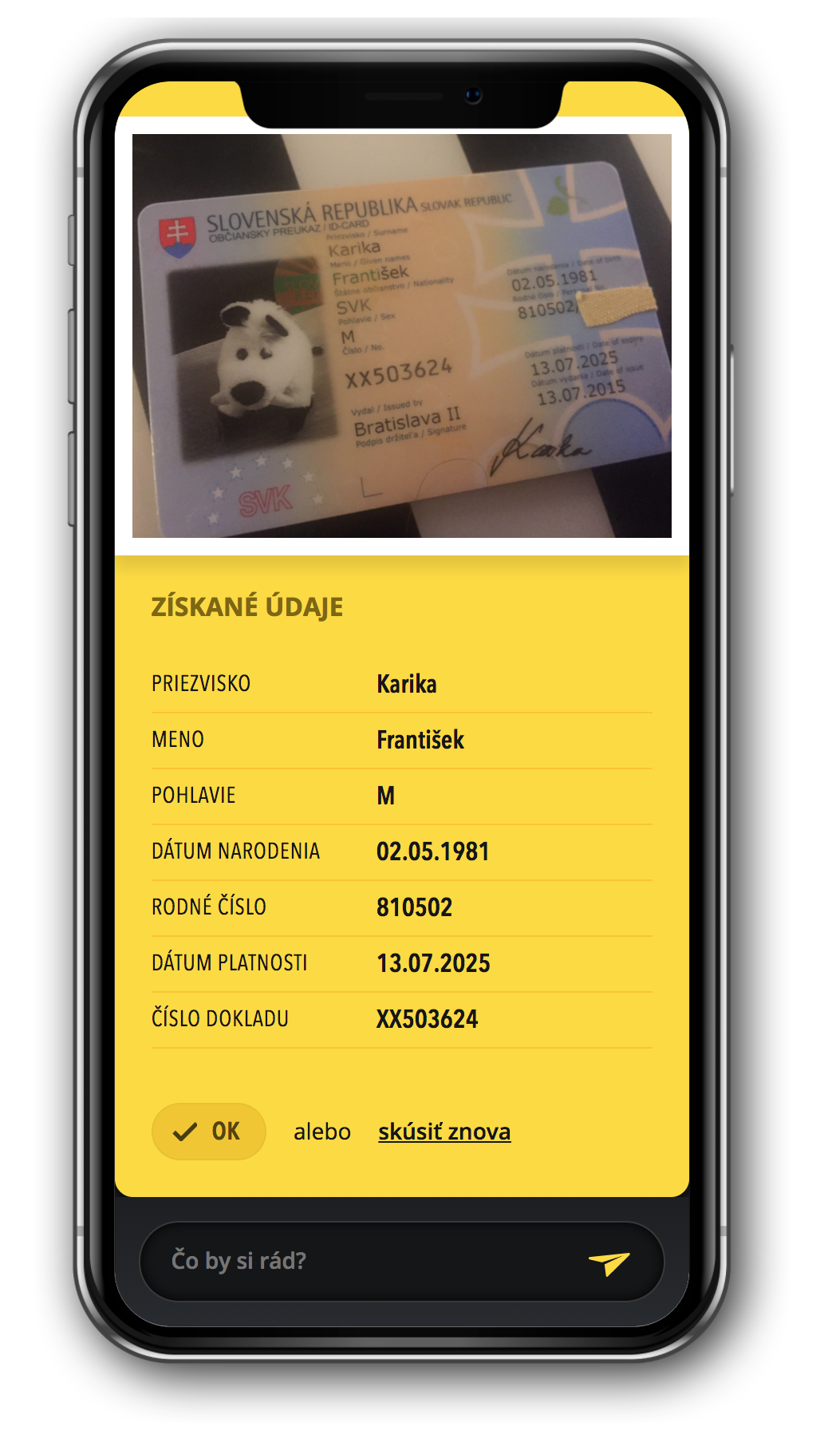
nettle AI chatbot in action

Slide 11
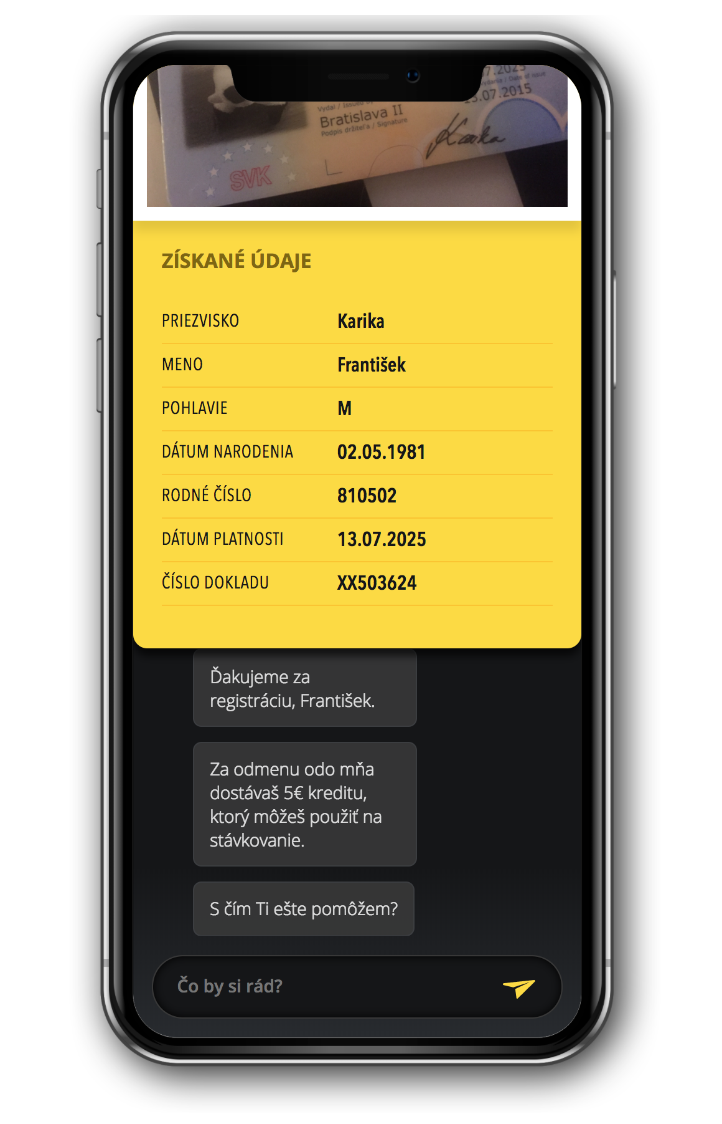
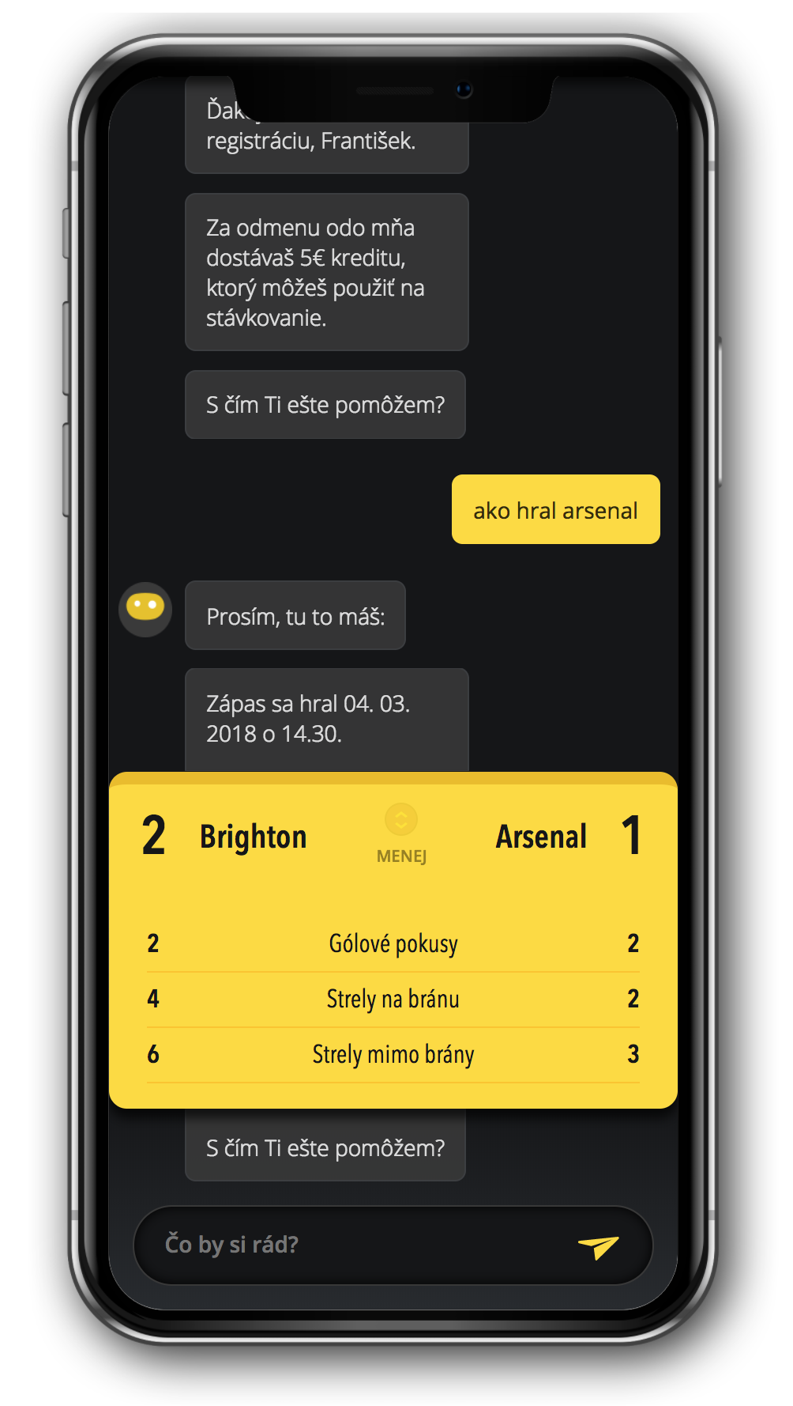
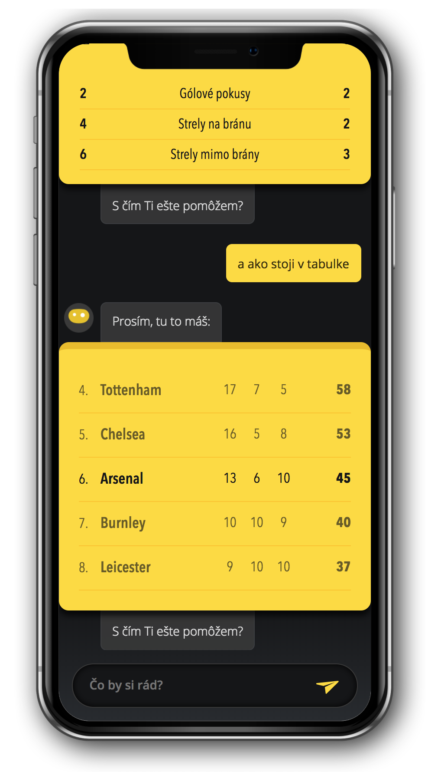
nettle AI chatbot in action

Slide 12
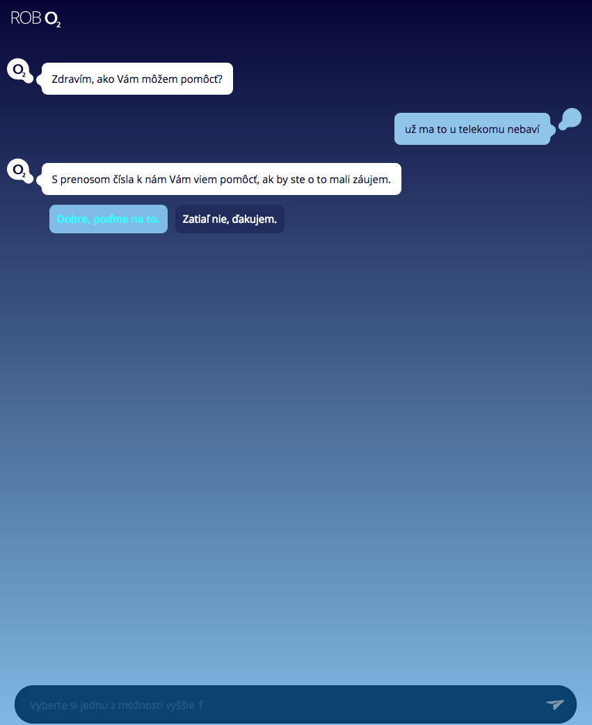
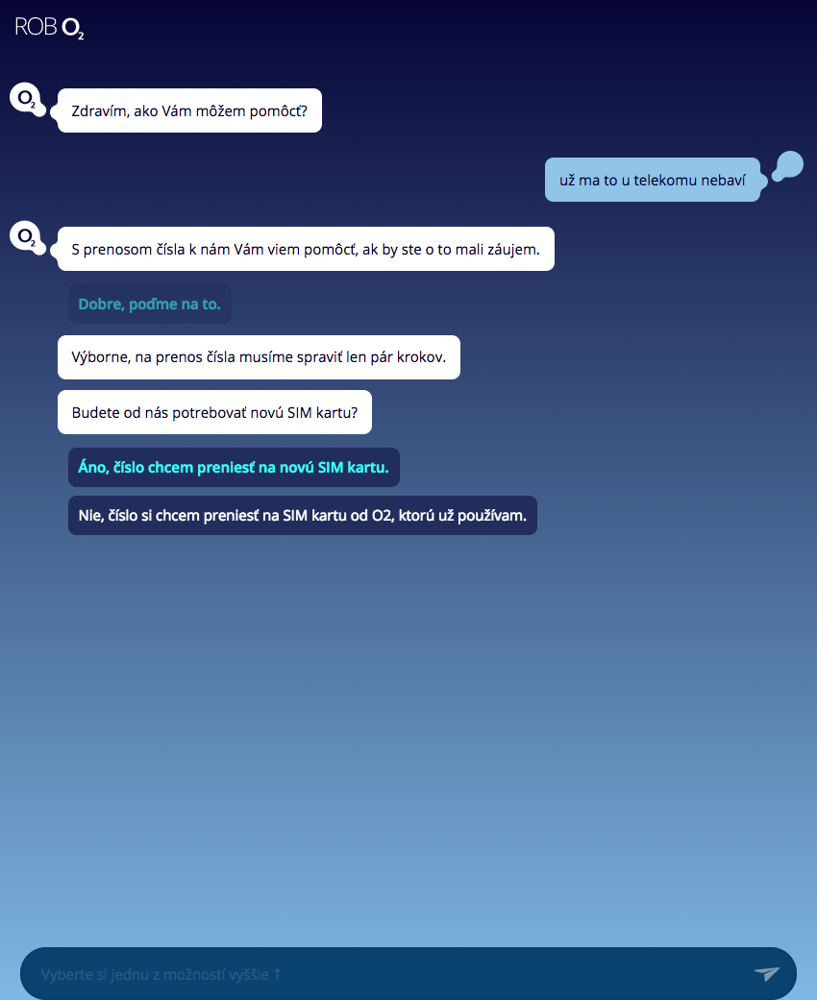
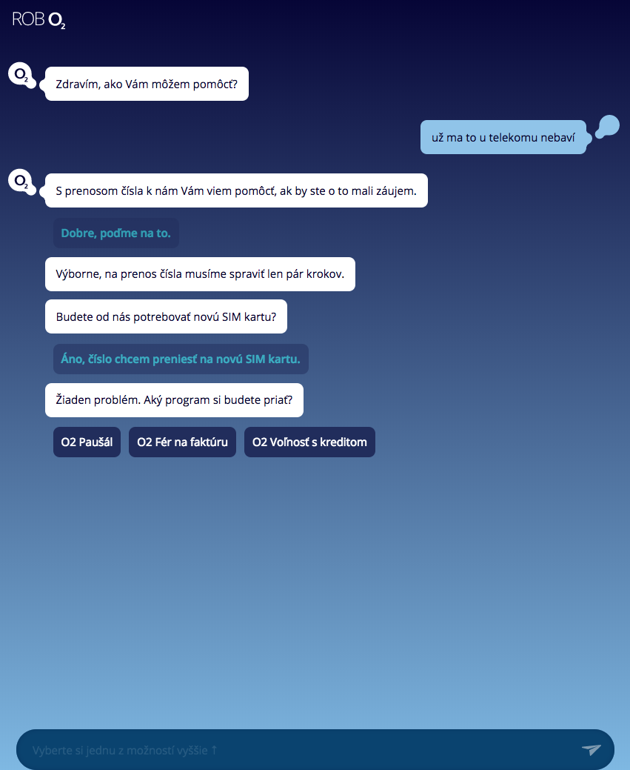
nettle AI chatbot in action

Slide 13
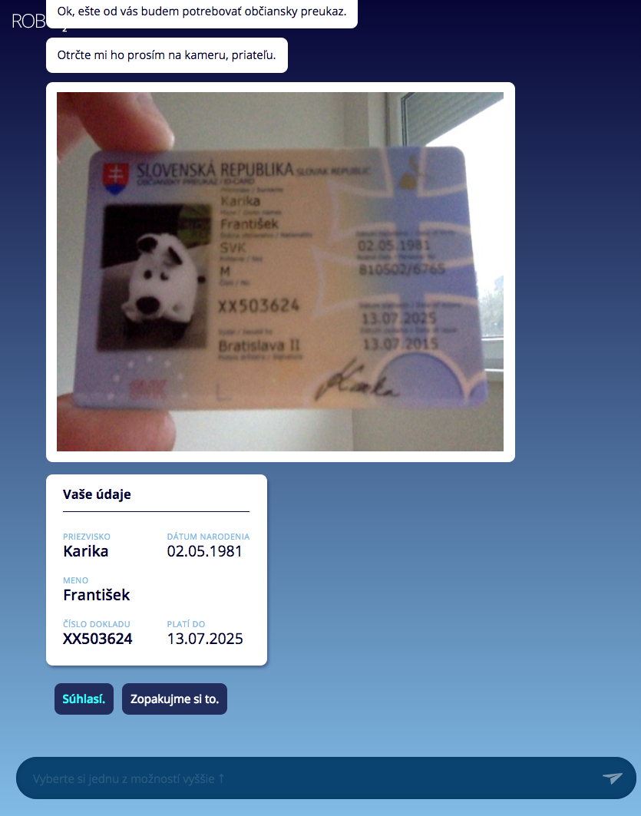
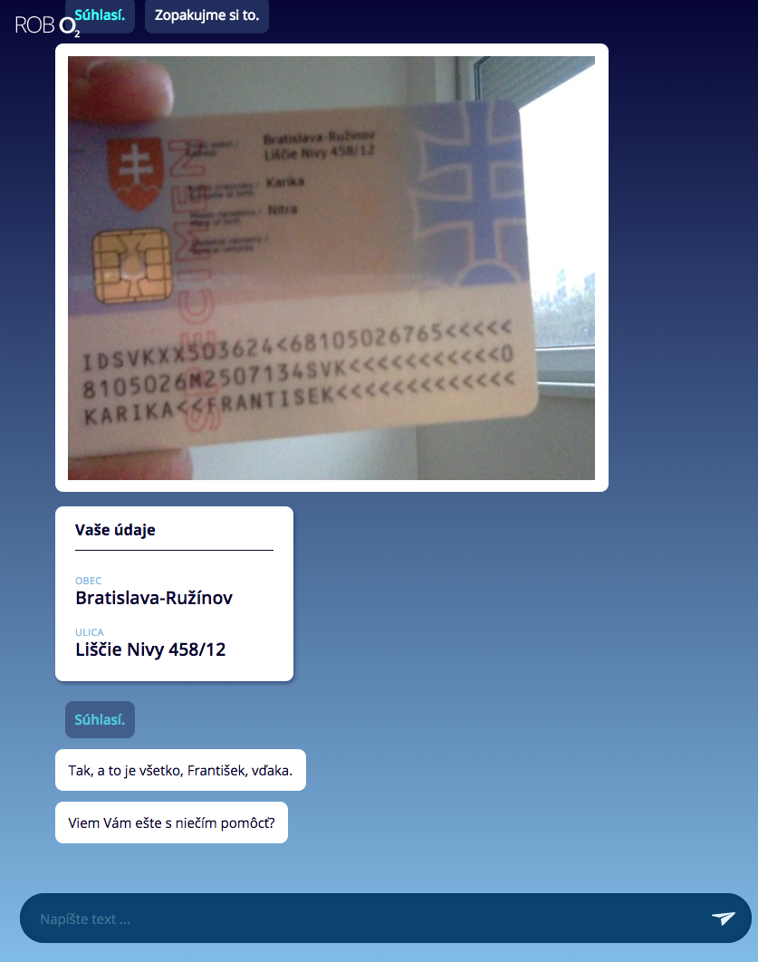
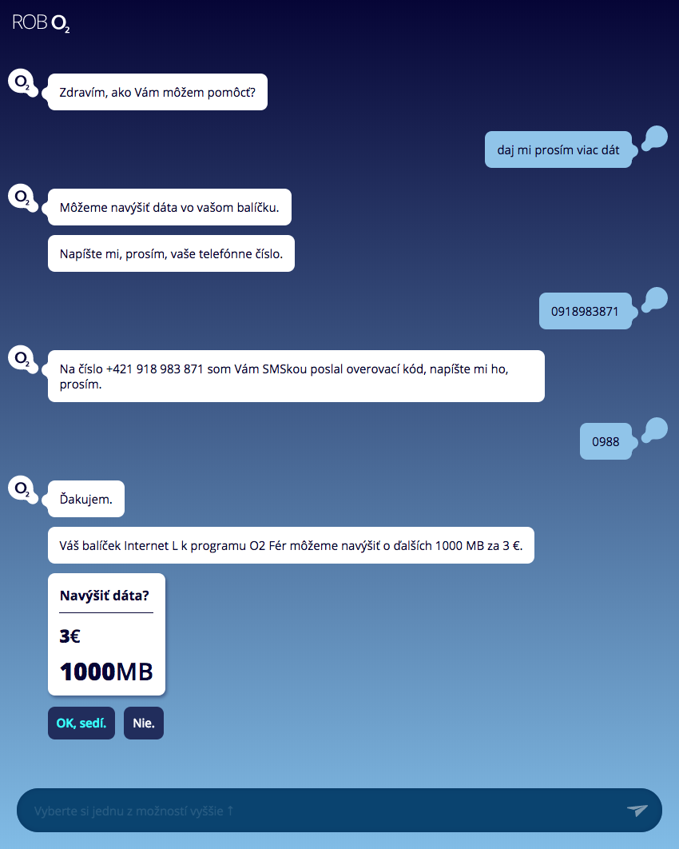
nettle AI chatbot in action

Slide 14
banner with chatbot
AI powered chatbot that lies within display ads
weave new life into traditional display ads
removing as many friction points from the customer journey as possible
87% lift in engagement compared to its traditional click-through ads (Emirates vacation campaign)

Slide 15
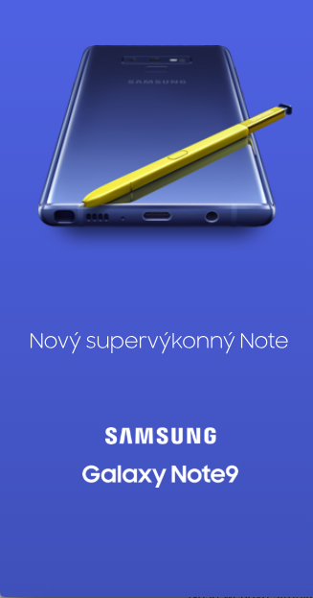
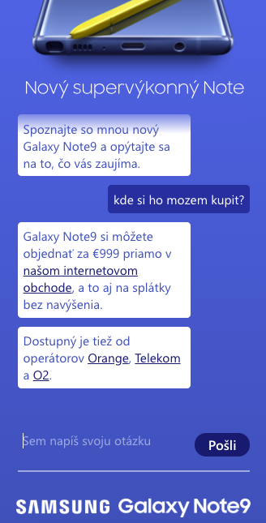
banner with chatbot
Launch campaign of the Galaxy Note9
1st banner with AI powered chatbot in Slovakia
ready to reply various phone related questions
Samsung topped up add impression during the campaign
CTR up to 4%

Slide 16
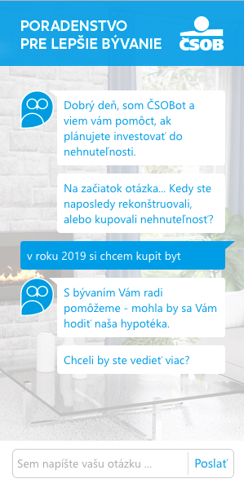
banner with chatbot
Loan campaign
one of the strongest and most important players in the Slovak banking market
part of KBC group
AI powered chatbot in add banner

Slide 17
nettle AI chatbot USP
AI based technology
in-house language capabilities: CZ & SK, EN, DE, HU
maximum data security, 100% server-side deployment option
ability to precisely extract intents and entities
integration with any messaging service
ID data pre-fill & verification
speech to text transcription
integration with Genesys
turnkey solution possibility

Slide 18
nettle AI chatbot moduls
parameter extraction
intent classification
NLP pipeline
accent correction
typo correction
conversation flowmanagement
named entity recognition

Slide 19
THANK YOU!
ahoj@nettle.sk
Tupého 29, 831 01 Bratislava

